Slide 1




GDSC UNILORIN IN NUMBERS
DATA GATHERED, ANALYZED AND PRESENTED BY GDSC UNILORIN

Slide 2




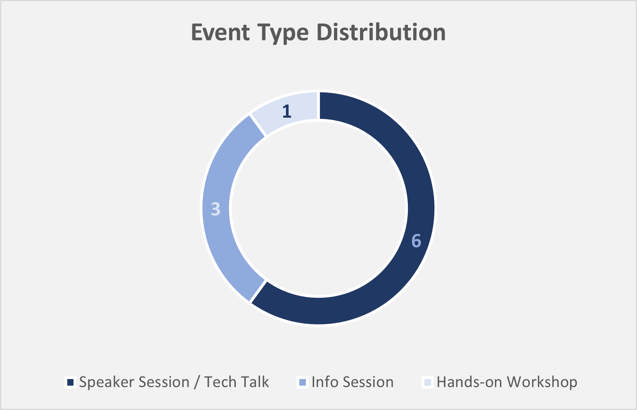
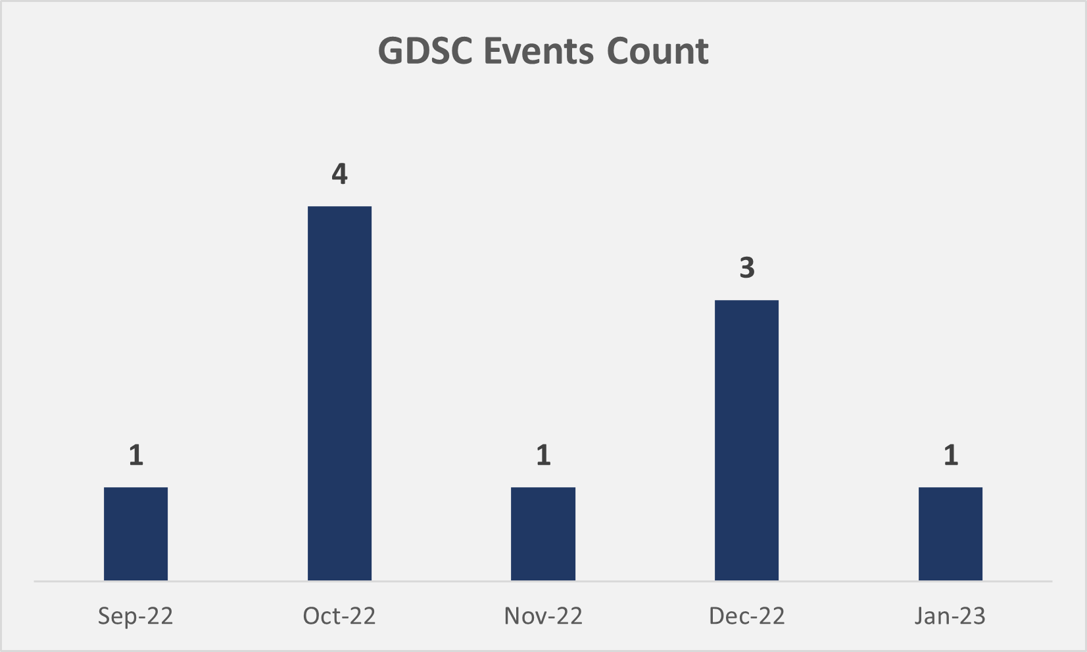
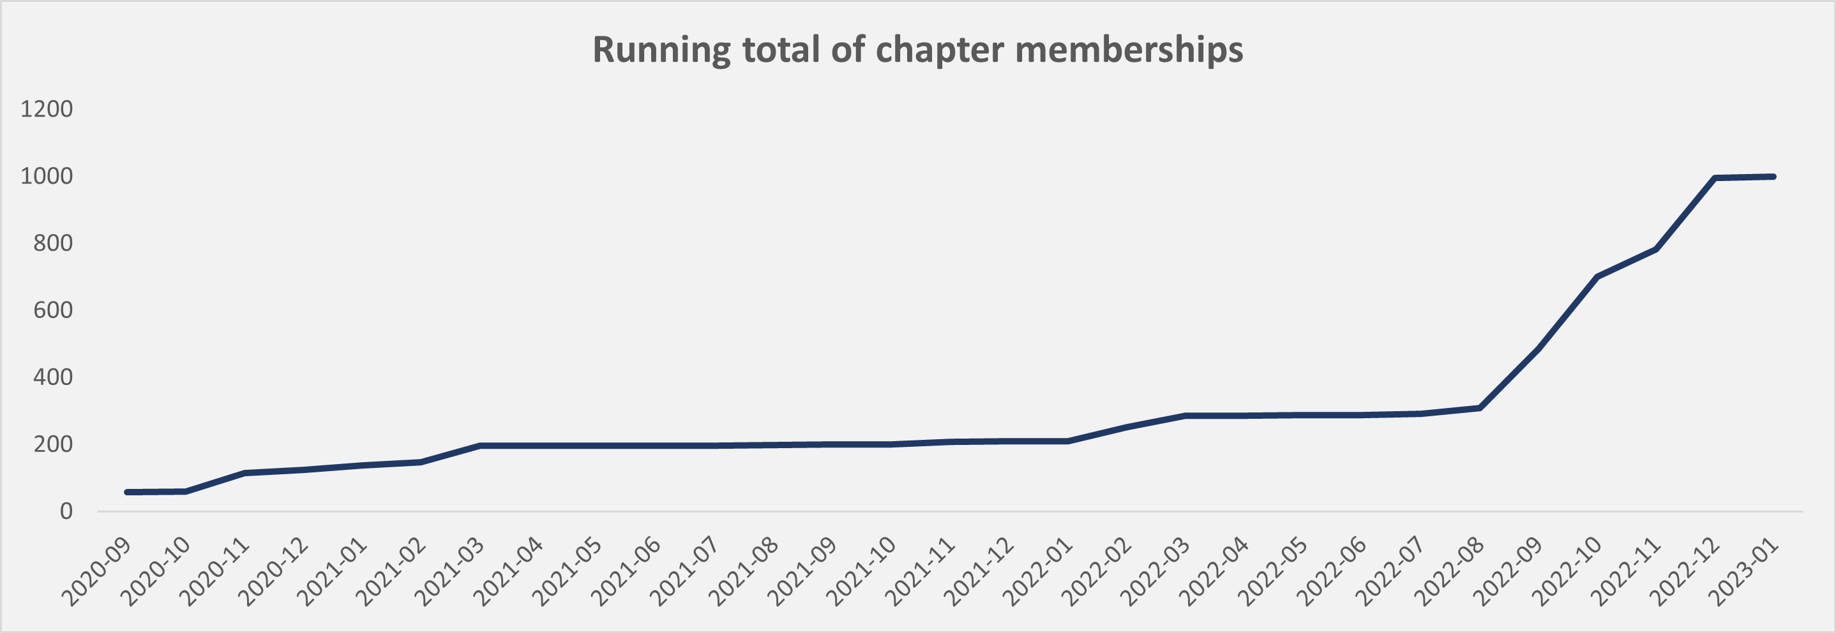
1008
Chapter Membership (All-time)
790
185
556
Followers
Followers
Followers
793
Chapter Membership (Sept 1st, ’22 – Jan 4th, ‘23)
22
Completed Events (All-time)
10
Completed Events (Sept 1st, ’22 – Jan 4th, ‘23)
1,607
Registered Attendees (All-time)
706
Registered Attendees (Sept 1st, ’22 – Jan 4th, ‘23)

Slide 3
REPORT SUMMARY
FAST GROWING
Within the last 4 months, GDSC University of Ilorin increased its membership by 383.1%. What makes this more interesting is that the club has been around for 4 years before the sudden surge in growth. This can be attributed to the management of the current GDSCU Core Team members as the timing coincides with when the new team took over.
ACTIVE
GDSC University of Ilorin is a very active community, always looking to bring impactful and pathfinding events to the community. We had only 706 attendees between September 2022 and January 2023 because we used Google Meet (which has a maximum capacity of 100 participants) for our virtual events. A huge number of request for event recordings signify that between 850-1300 attendees would be interested in a physical event.
DIVERSE
GDSC University of Ilorin is always mindful of its community members’ interests and, as such, we roll out Google Forms frequently to get feedbacks from the community. This has led the team to organize ten (10) different events – six (6) Speaker sessions, three (3) Info Sessions and a Hands-On workshop within the last four (4) months. There would be another workshop on the 21st of Jan, 2023.
STRONG MEDIA PRESENCE
GDSC University of Ilorin have an active social media audience on Twitter, LinkedIn, Instagram and WhatsApp with engagement on all of our posts and with new followers every day.
The data used in this report was updated by January 6th, 2023

